Slide 1

CAPSTONE
PROJECT
By Dobanaboina Bhavika
Student id :811323122
:

Slide 2




Content:
Introduction
Problem statement
About Data set
Data Cleaning
Data Transformation
Data Exploration
Data Partition
Model selection
Model Building
Model’s performance Evaluation
Choosing the Right Model- Performance comparison
Insights & Conclusions
variables

Slide 3



Problem Statement:
Predicting term deposit subscriptions using marketing data to optimize strategies and boost campaign success.

Slide 4
About Dataset:
This dataset is collected from UCI Machine Learning Repository, it records phone-based direct marketing campaigns of a Portuguese bank, often requiring multiple contacts to determine if clients would subscribe to a bank term deposit ('yes') or not ('no’).
Number of rows: 45,212
Number of Columns: 17
Target Variable: y
Number of Categorical Variables: 9
Number of Numerical Variables: 8

Slide 5
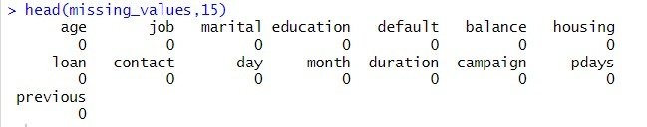
Data Cleaning
The data was examined carefully to identify missing values, inconsistencies, spelling errors and duplicates.
Missing Values: Percentage of missing values in each column was calculated
No missing values has been found.

Slide 6
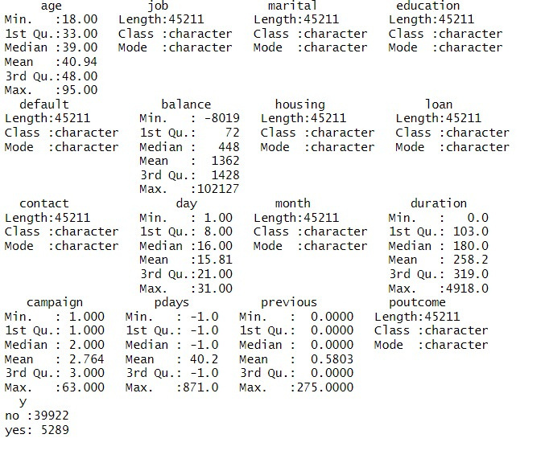
Data Exploration:
Descriptive statistics of all columns:

Slide 7
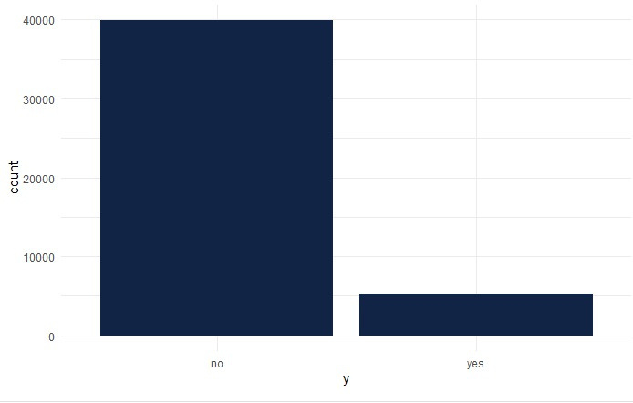
Data Exploration (contd.):
.
Only 5000 out of 45000 customers subscribed to the term deposit, indicating imbalanced data, necessitating the use of a sampling technique to balance the classes.

Slide 8
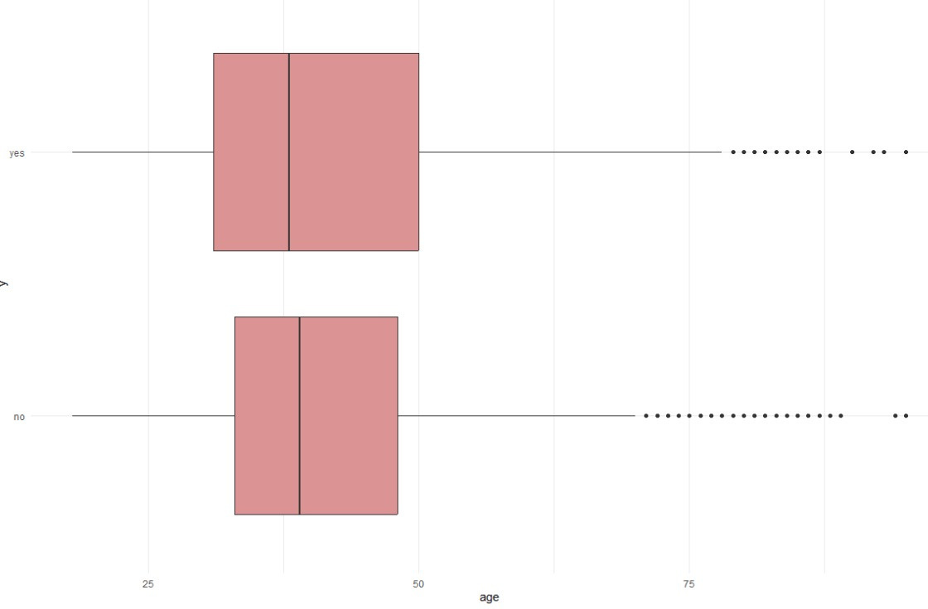
Data Exploration (contd.):
02
03
customers with Median age of 30 have subscribed to the term
deposit and customers between the age of 35 and 45 have not subscribed.

Slide 9
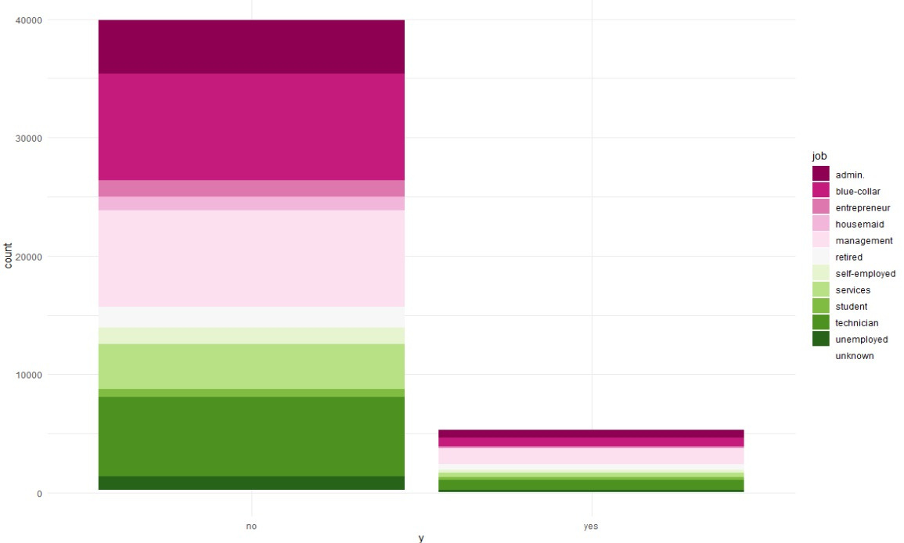
Data Exploration (contd.):
.
Most non-subscribers are unemployed, students, in services, self-employed , housemaids, blue-collar, or in management.

Slide 10
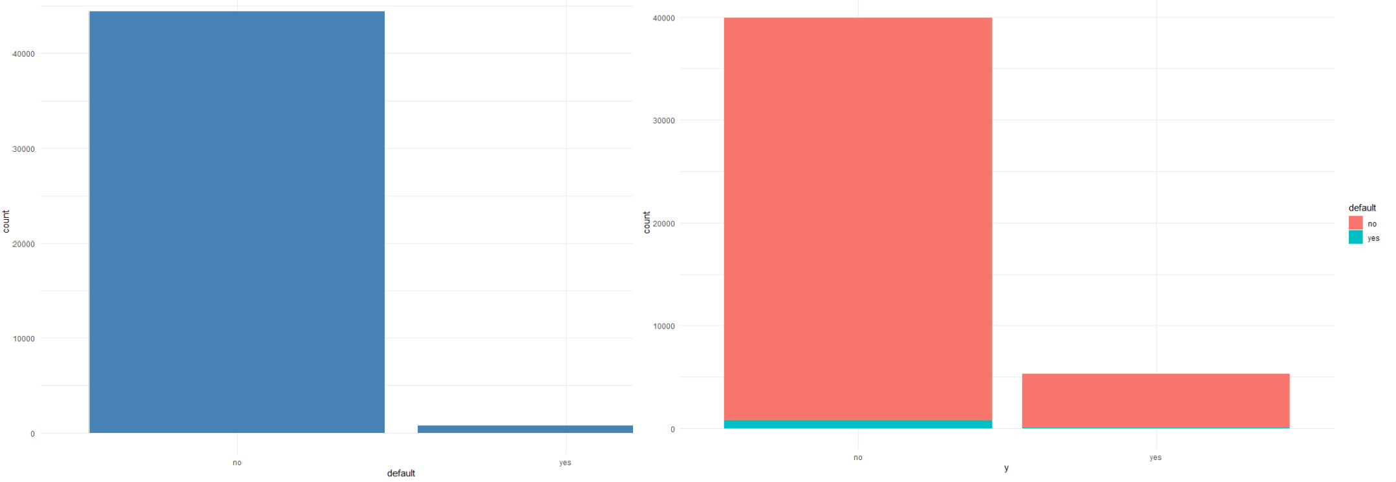
Data Exploration (contd.):
.
.
.
It is obvious that the customers with unpaid debts have not subscribed to the term deposits.

Slide 11
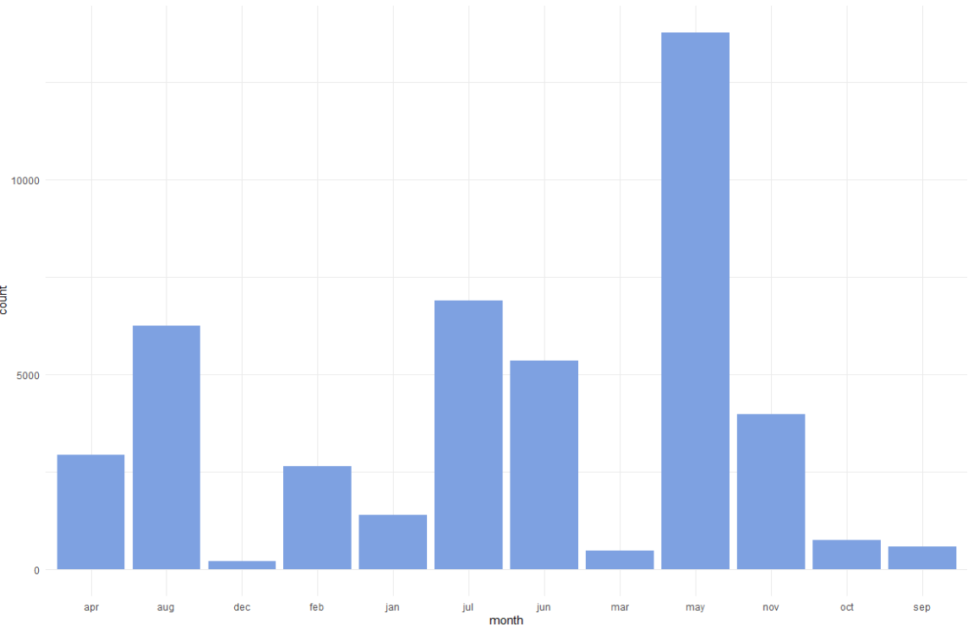
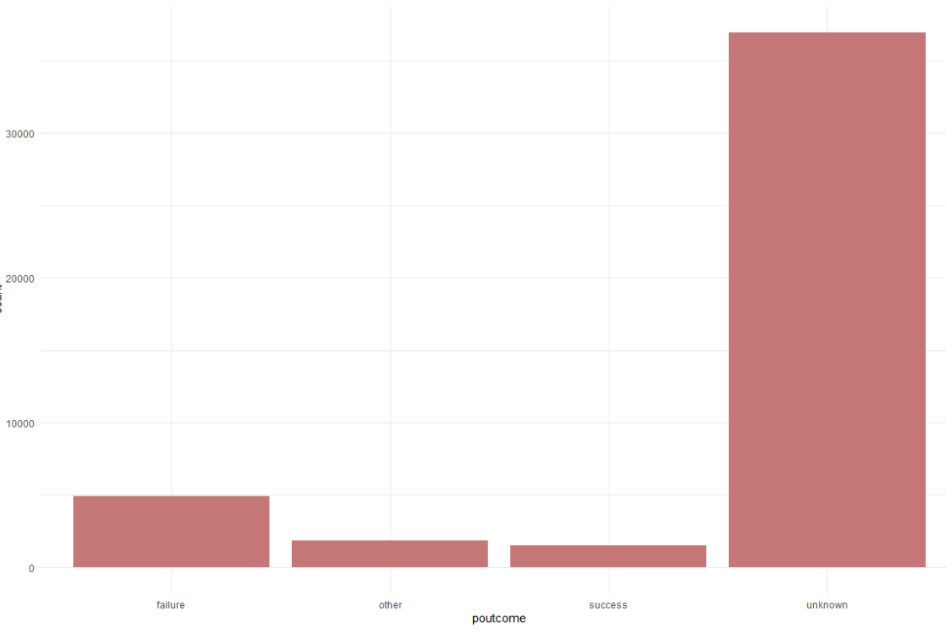
Data Exploration (contd.):
During the previous campaigns, the bank reached out to more customers between April and August.
As we can see, the success rate of previous campaigns is very low.

Slide 12
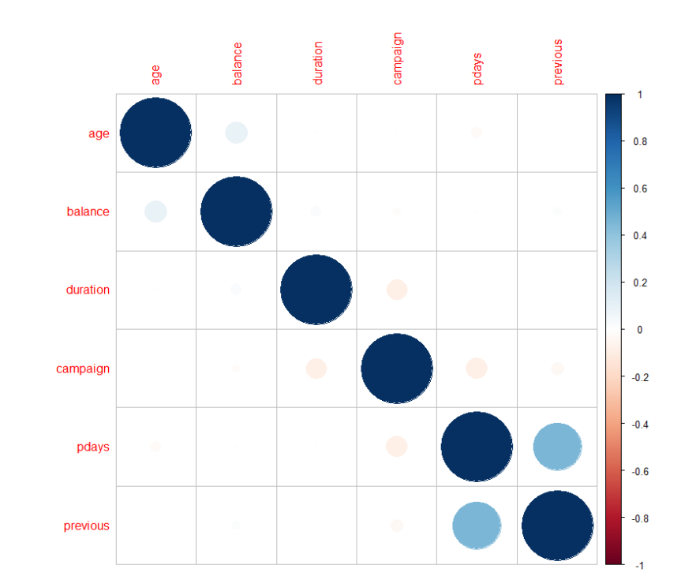
Data Exploration (contd.):
The correlation matrix shows a positive correlation of balance, age, and previous campaigns with the number of days customers were previously contacted, and a negative correlation between the campaign and phone call duration.

Slide 13

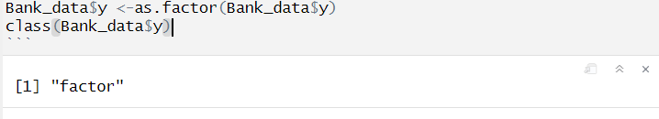
Data Transformation
Data Transformation
Converting “y” column (target variable) to factor with 2 levels having values “yes” and “no”. These 2 classes indicate whether a customer would subscribe to term deposit or not.
Each class of every categorical variable has been transformed into a new variable with values 0
and 1.numerical variables
There are 52 columns altogether after transforming categorical variables to Numerical Variables.

Slide 14

Data Partition
This dataset was partitioned into Training, validation and Test datasets with 70% of data being in the Training set, 15% in Validation and the remaining 50% in Test Dataset.
Training datasets will be used to train the models and Validation set will be used to tune the hyperparameters. After tuning hyperparameters, the model with the best evaluation metrics will be considered as the final model and that final model will be deployed on to the Test dataset (Unseen data).

Slide 15
Model Selection
As the Target variable is a categorical variable, below models were chosen:
KNN
Logistic Regression
Decision Trees

Slide 16
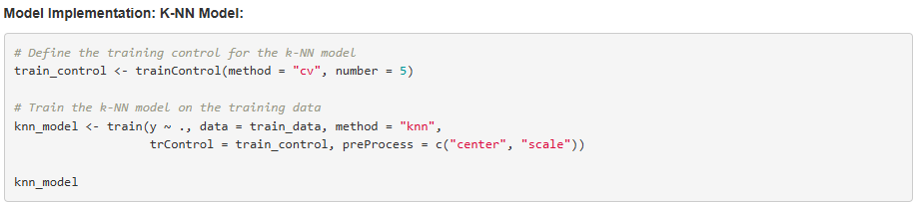
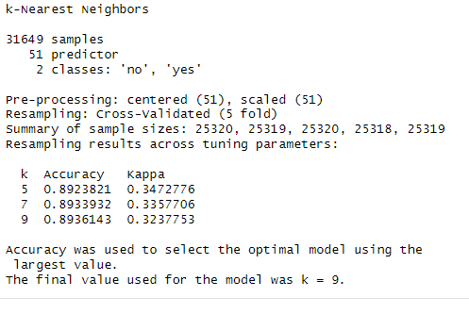
Model Building: K-NN Model
5-fold cross-validation has been used on the Training dataset and KNN model was implemented.

Slide 17
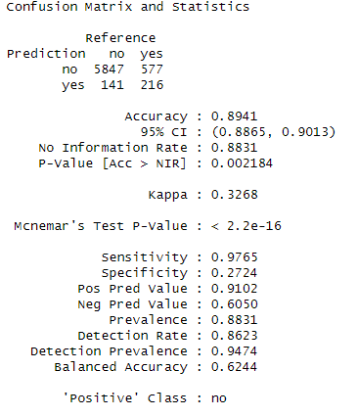
Performance Evaluation : K-NN Model
This model was then deployed onto Validation dataset and Confusion Matrix was used as the performance measure.

Slide 18

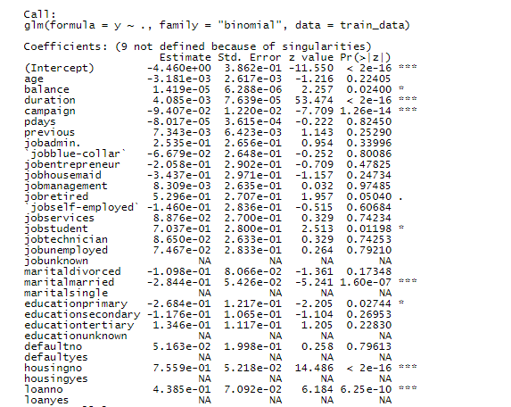
Model Building: Logistic Regression
Logistic regression predicts class probabilities and classifies instances based on a set threshold, making it straightforward to interpret.
It offers probabilistic outcomes with minimal hyperparameters, aiding in confident decision-making.

Slide 19
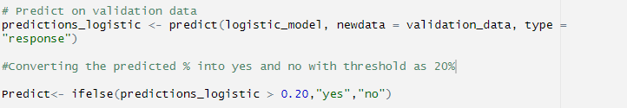
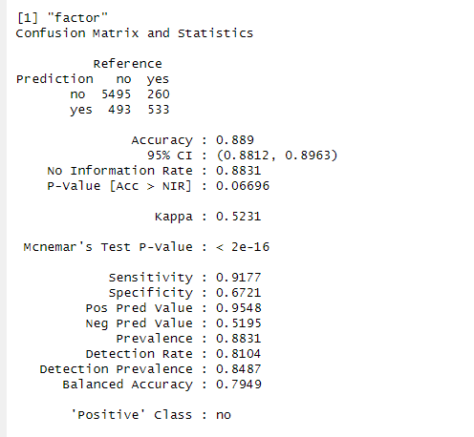
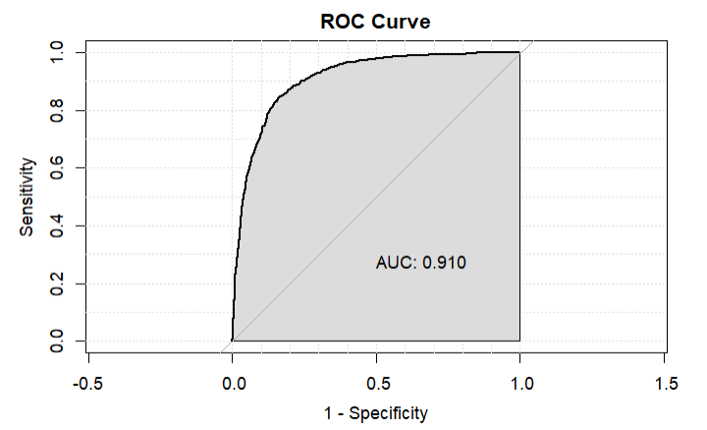
Performance Evaluation: Logistic Regression
A classification threshold of 20% was considered appropriate as we want to predict every customer who would subscribe to a term deposit.

Slide 20
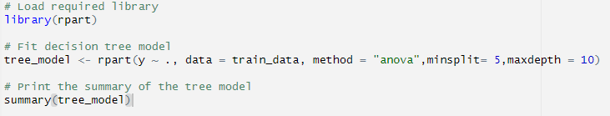
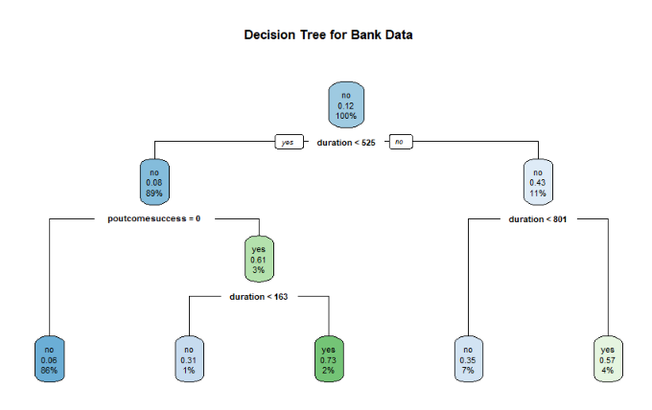
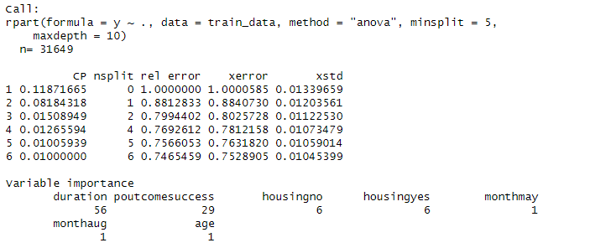
Model Building: Decision Trees

Slide 21
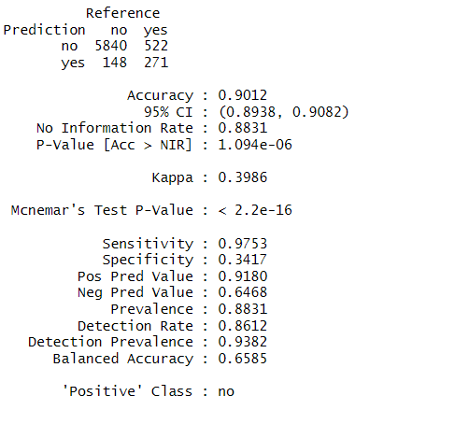
Performance Evaluation: Decision Trees
After tuning Hyperparameters, model was deployed on to the Validation set and below are the results:

Slide 22
Recall of K-NN Model: 27% Recall of Logistic Regression: 67% Recall of Decision Trees model: 35%
Comparing the results of 3 models:
As our problem is predicting if a customer will subscribe to the term deposit or not, it is important for the bank to identify all customers who would subscribe so that they can target their marketing campaigns towards those customers.
. Hence, instead of considering Accuracy as an evaluation metrics (which does not account for Type 1 and Type 2 errors), we would consider Recall as an evaluation metrics.

Slide 23
Insights from Model and EDA:
The duration of the last contact is the most significant predictor.
The previous marketing campaign outcome (poutcomesuccess) significantly influences the prediction.
The model provides probabilistic outcomes, aiding in decision-making based on confidence levels.
5000 customers have subscribed to the term deposit, out of 45000 customers.
Customers with a Median age of 30 have subscribed to the term deposit and customers between the age of 35 and 45 have not subscribed.
Among the customers who have not subscribed to the term deposits, most of them are unemployed, student, services, self-employed and housemaids. Interestingly, customers who have blue-collar and management qualifications have also shown no interest in subscribing to term deposits.
Most customers with unpaid debts and personal loans have not subscribed to the term deposits.
During the previous campaigns, the bank reached out to more customers between April and August. However, the success rate of previous campaigns is very low.

Slide 24
Thank you
.

